Slide 1

Digital Portfolio
STUDENT NAME: VIGNESH R
REGISTER NO AND NMID: 2422k2224 & A74B6F94B5EDA21BBE840434741D4D99
DEPARTMENT: BSC (COMPUTER SCIENCE)
COLLEGE: COLLEGE/ UNIVERSITY:PTA GASE-PALLADAM,BHARATHIAR UNIVERSITY

Slide 2
PROJECT TITLE: Digital portfolio
VIGNESH R

Slide 3
AGENDA
Problem Statement
Project Overview
End Users
Tools and Technologies
Portfolio design and Layout
Features and Functionality
Results and Screenshots
Conclusion
Github Link

Slide 4

PROBLEM STATEMENT:
Students often struggle to present their academic achievements, skills, and projects in a structured and professional manner. Traditional resumes fail to capture creativity, practical skills, and hands-on experiences, making it difficult for students to stand out in academic or career opportunities. There is a need for a digital portfolio solution that allows students to effectively showcase their competencies, projects, and growth.

Slide 5

PROJECT OVERVIEW
By developing this portfolio system, students will have a personalized digital identity that goes beyond a traditional CV, enhancing their chances of securing opportunities in competitive environments. It will also provide academic institutions and recruiters with a reliable and holistic view of a student’s potential

Slide 6
WHO ARE THE END USERS?
Primary End Users: Students
Secondary End Users: Employers, recruiters, faculty, mentors, admission officers

Slide 7

TOOLS AND TECHNIQUES
TOOLS:
* TREBEDIT
TECHNIDES:
*HTML
*CSS
*JAVASCRIPT

Slide 8
POTFOLIO DESIGN AND LAYOUT
A well-designed portfolio layout ensures clarity, professionalism, and impact while making it easy for recruiters and mentors to quickly assess a student’s strengths.
8

Slide 9
FEATURES AND FUNCTIONALITY
🔹 About
This section is where you introduce yourself.
Example:
"I am. Computer Science student. I am passionate about learning new technologies and improving my skills in programming and development.
🔹 Certificates
Here you list your achievements – online courses, workshops, or competitions.
Example:
Completed Python Programming Course.
Attended Web Development Workshop.
Certificate in Data Science Basics.

Slide 10
🔹 Education
This section shows your study background.
🔹 Skills
Here you highlight what you can do.
🔹 Contact Your contact information so people can reach you.

Slide 11
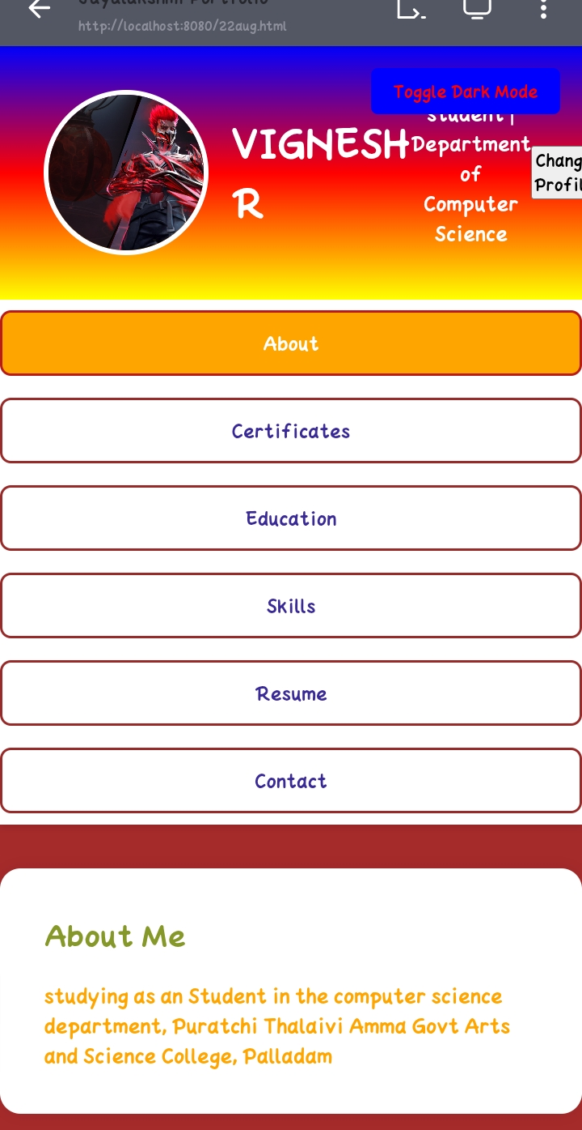

RESULTS AND SCREENSHOTS
3/21/2024 Annual Review
11

Slide 12
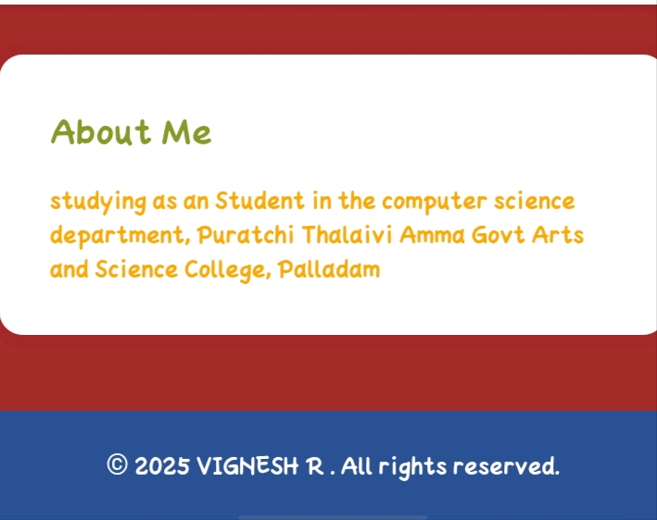
RESULTS AND SCREENSHOTS

Slide 13
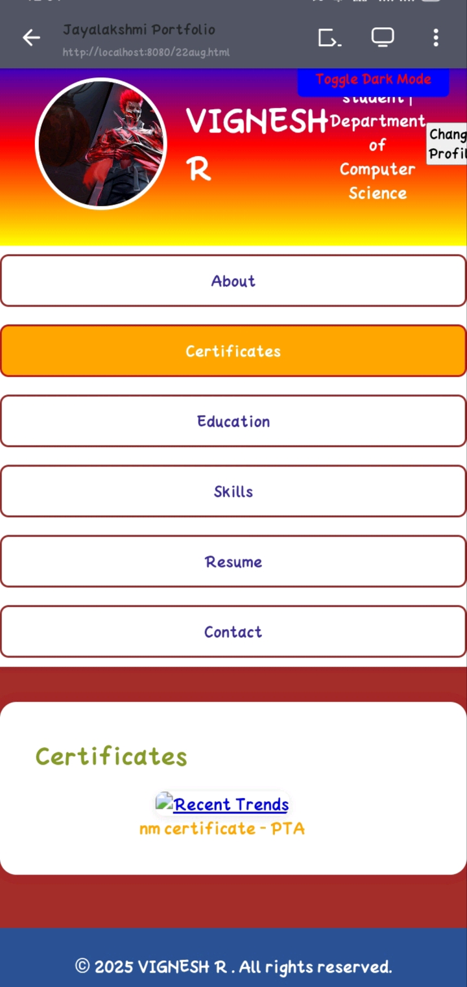
RESULTS AND SCREENSHOTS

Slide 14

RESULTS AND SCREENSHOTS

Slide 15
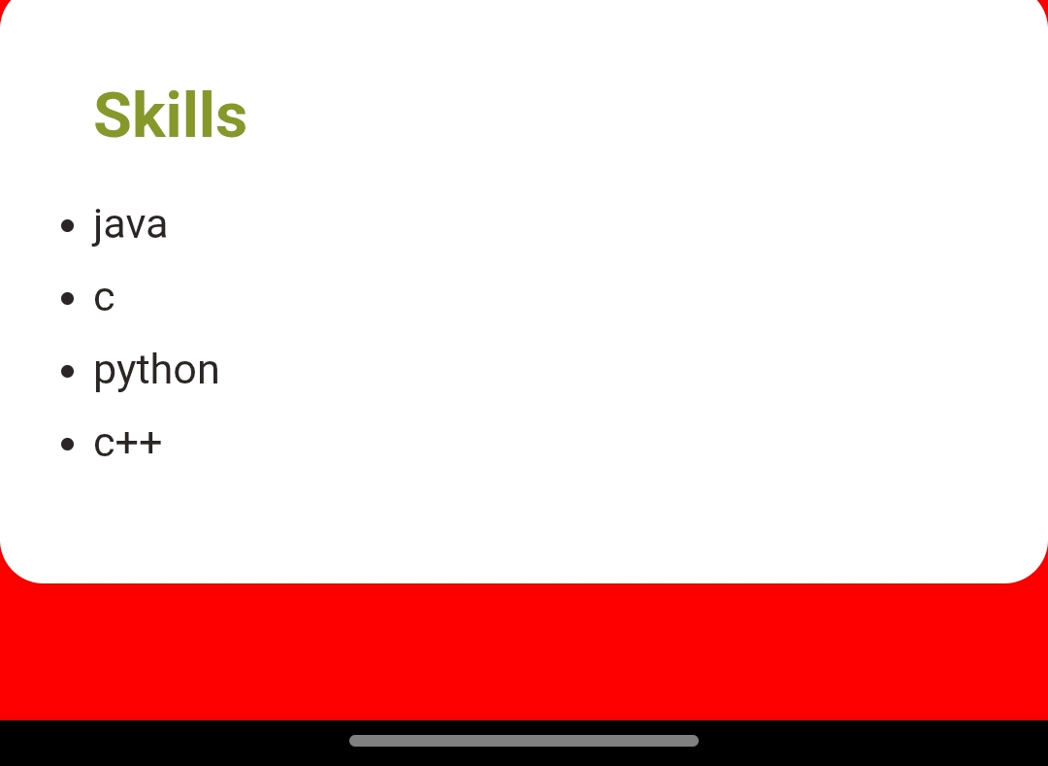
RESULTS AND SCREENSHOTS

Slide 16
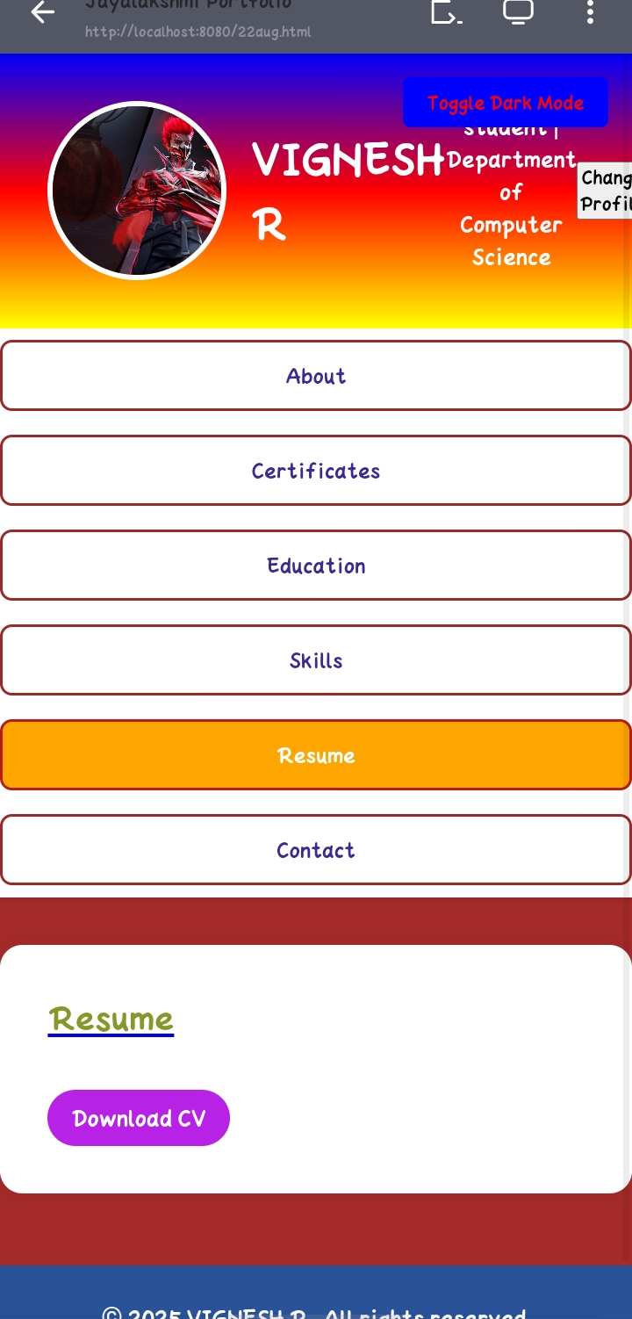
RESULTS AND SCREENSHOTS

Slide 17
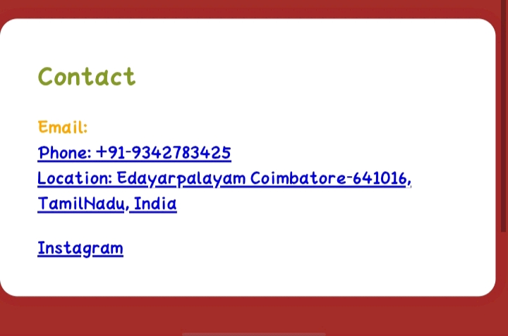
RESULTS AND SCREENSHOTS

Slide 18
CONCLUSION
Responsive Design using media queries for better mobile compatibility.
Tab Navigation to switch between sections smoothly.
Dark Mode Toggle for enhanced user experience.
Password-protected Profile Image Update with local storage support.
Certificate Showcase and External Links for social media and published works.
18

